Slide 1

AI-powered classification of the diabetic retinopathy severity
Thanh Thao Nguyen

Slide 2
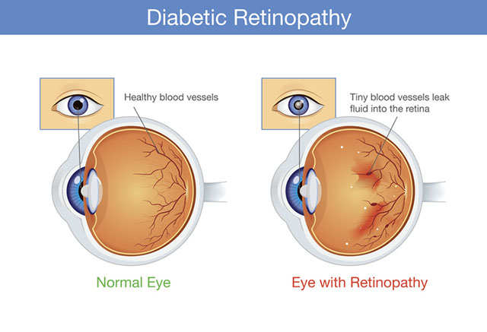
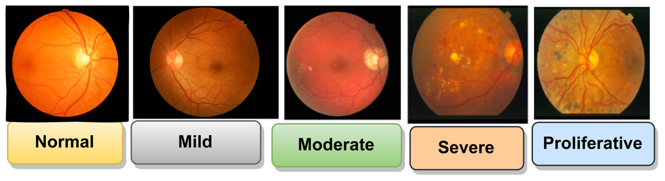
Introduction (1/2)
Comparison between Normal Eye and Eye with Retinopathy
The severity of Diabetic Retinopathy ranges from Normal to Proliferative

Slide 3
Introduction (2/2)
Objective
To develop a deep learning-based solution for classification that can automatically identify and extract diabetic retinopathy from high-resolution retinal imagery.
Why It Matters
Accurate diabetic retinopathy classification is crucial for personal treatment planning, patients’ physical and mental health care, and cost-saving.
The traditional method is time-consuming.
Automating this process increases efficiency, scalability, and medical intelligence.

Slide 4
Key terms to remember
The accuracy of the training and validation set Measure the accuracy of the training and validation once the training model. The higher the accuracy gets, the better the model achieves.
Test Accuracy Evaluate how accurate the model is on the test set. We pick the model that has the best performance.
Confidence Score Evaluate the accuracy of the model when it predicts the real images (does it classify the class correctly?).
EfficientNetV2B3 This model is more accurate than EfficientNetB0, ResNet50, DenseNet121, and Vision Transformer ViT-Ti/16.

Slide 5
Methodology Overview
Use the EfficientNetV2B3 architecture with its pre-trained model on ImageNet.
Leverage GlobalAveragePooling2D for extracting the features of images.
Resize images to 224x224 pixels (match with EfficientNetV2B3).
Keep the image in the original range (0-255).
Do evaluation using Test Accuracy and Confidence Score.

Slide 6
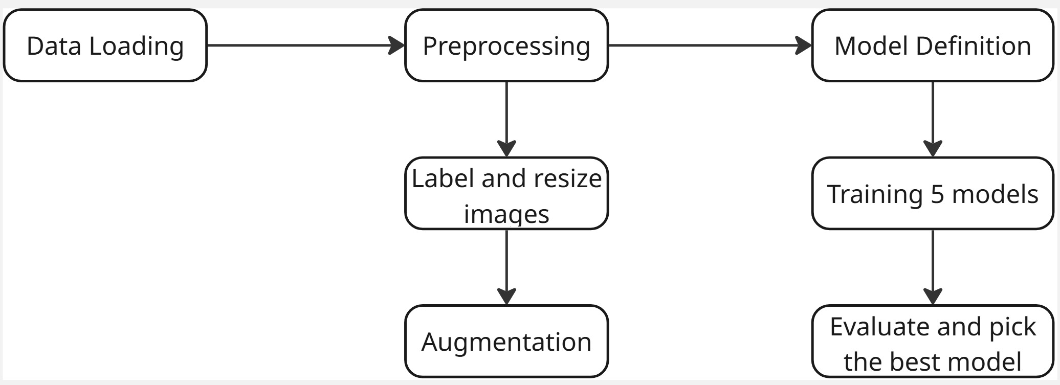
Project Diagram

Slide 7
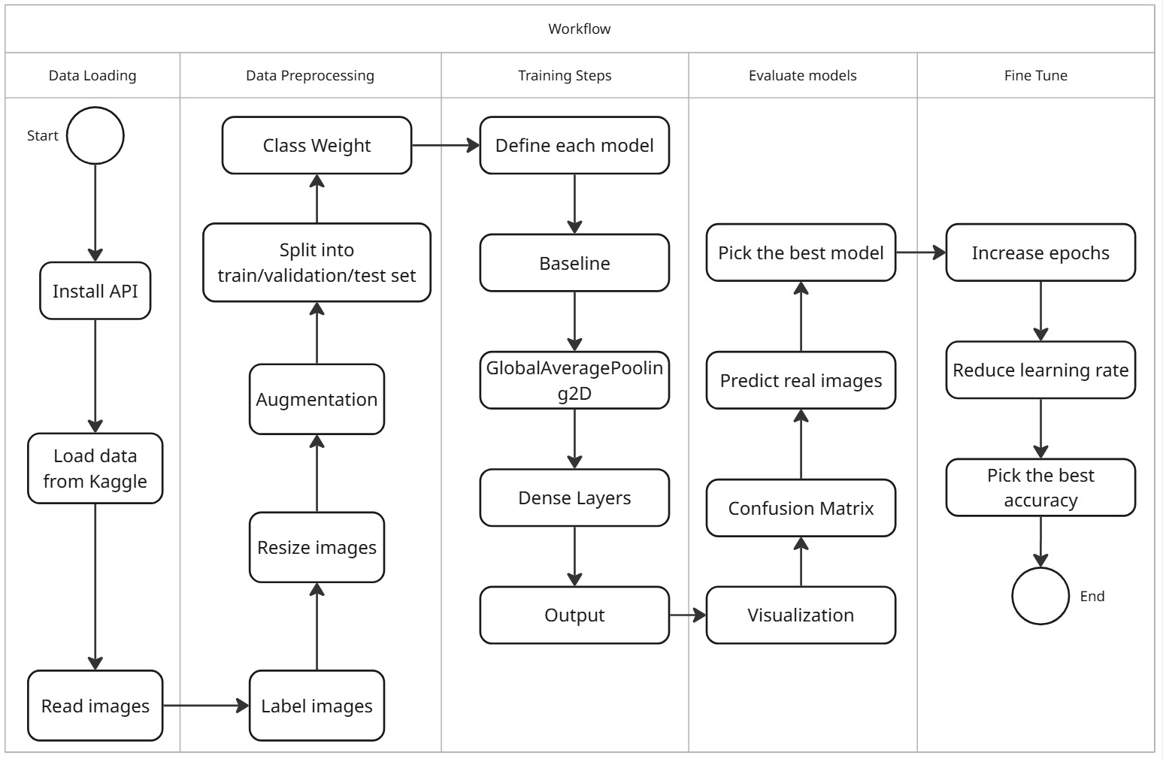
Project Workflow

Slide 8
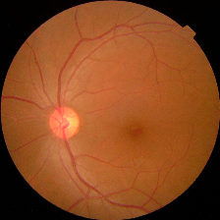
Dataset Overview
Acknowledgement
The images consist of retina scan images to detect diabetic retinopathy. The original dataset is available at APTOS 2019 Blindness Detection.
Data
The whole dataset contains 3663 retinal images.
These images are resized into 224x224 pixels.
The images are high resolution.
To download data : “Diabetic Retinopathy 224x224 (2019 Data) “

Slide 9
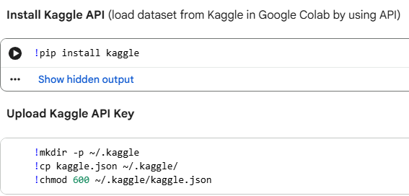
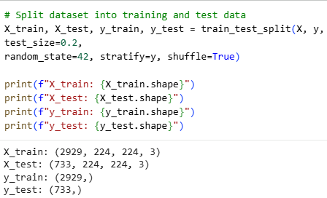
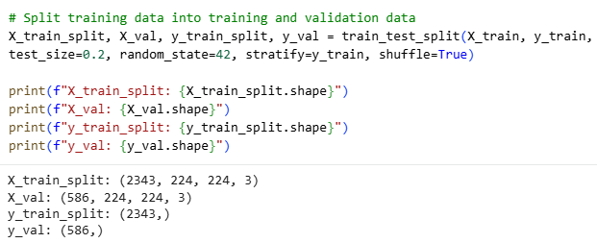
Data Loading
Dataset Split
The dataset is split into train, validation, and test sets.
The train set contains 2343 images.
The validation set contains 586 images.
The test set contains 733 images.

Slide 10
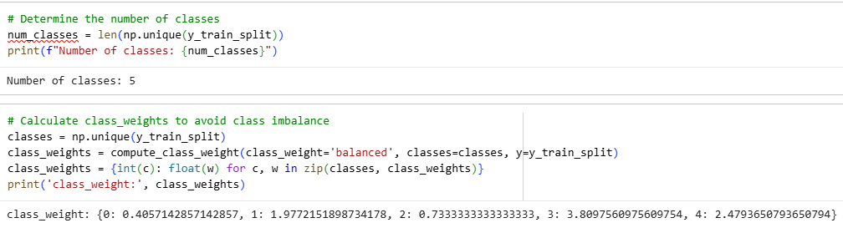
Data Preprocess
Description
Label images 0,1,2,3,4 with 0_NoDR, 1_Mild, 2_Moderate, 3_Severe, and 4_Proliferative.
Resize images 224x224 pixels.
Determine the number of classes
Class Weights

Slide 11
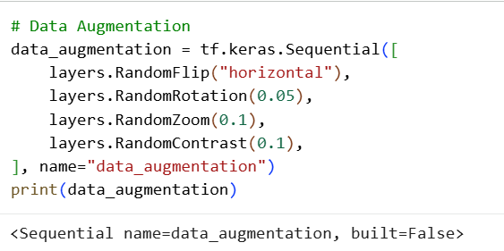
Data Augmentation
Description
Random flip (Horizontal) – simulate retinal orientations.
Random rotation (from -9° to 9°) – account for angled views.
Random zoom (10%) – zoom in or zoom out images.
Contrast adjustment (10%) – mimic different lighting conditions.

Slide 12
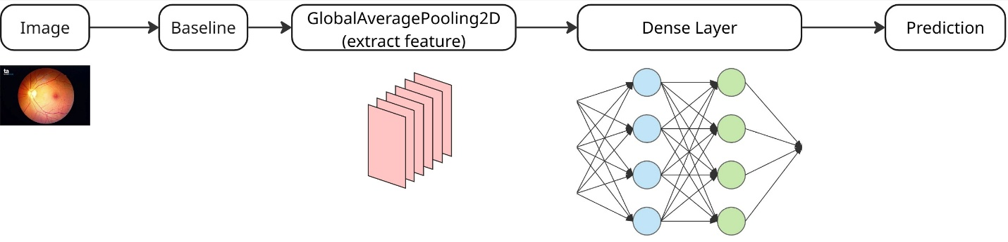
Model Architecture
Description
Baseline: base_efficientnetv2b3_model (pre-trained model on ImageNet)
GlobalAveragePooling2D is used to extract rich hierarchical features from input images.
Dense Layers (Hidden Layers) study the features of images.
Prediction (Output Layers) uses the activation function “softmax”

Slide 13
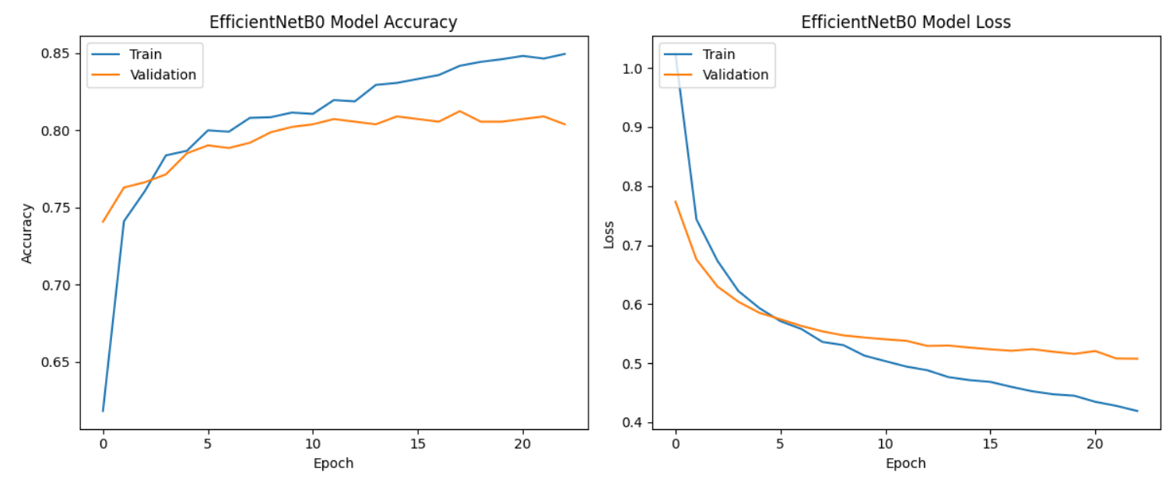
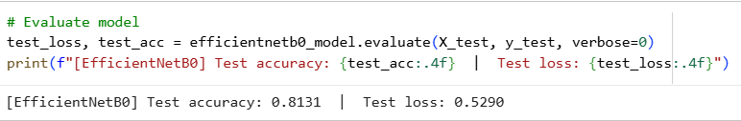
Model Evaluate (1/6)

Slide 14
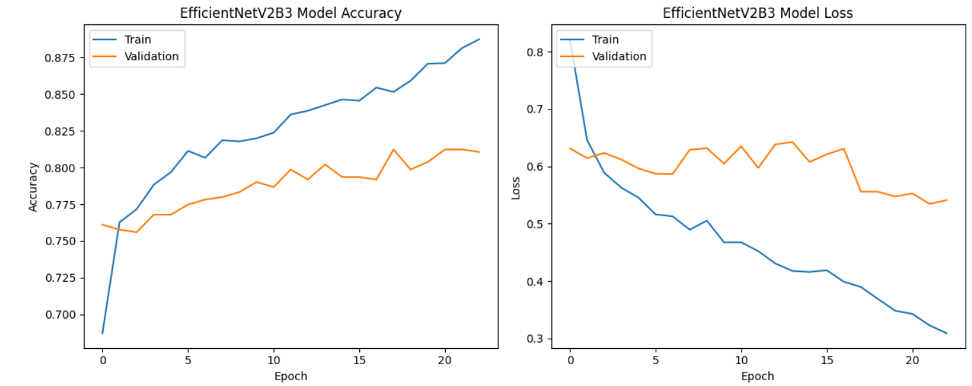
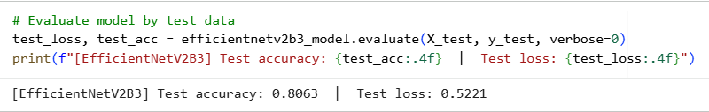
Model Evaluate (2/6)

Slide 15
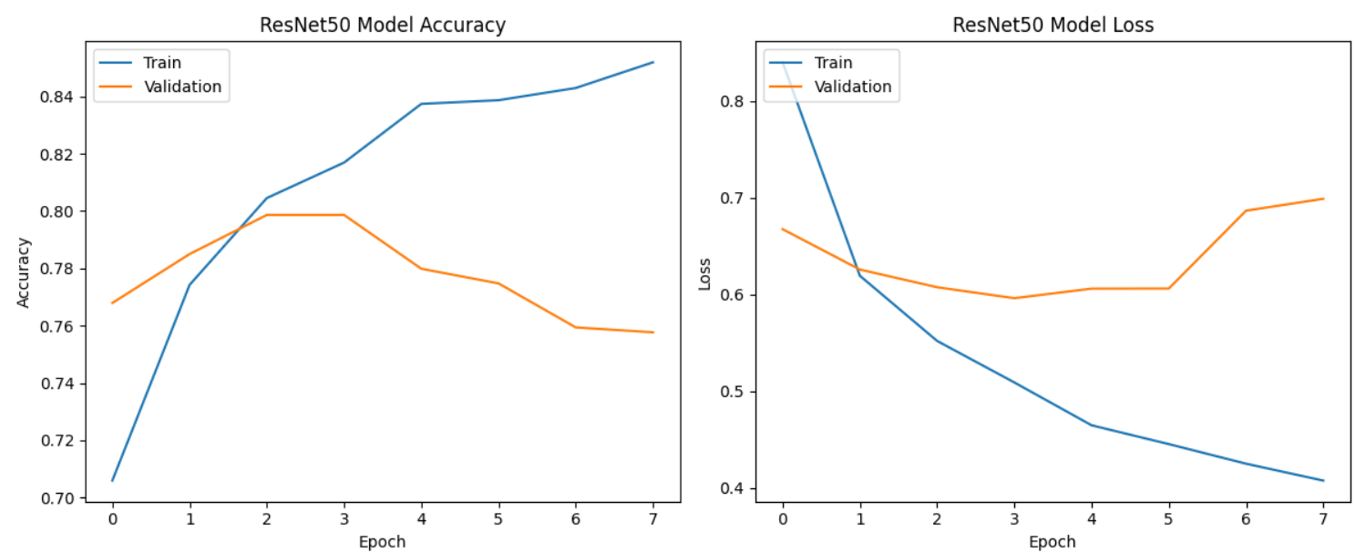
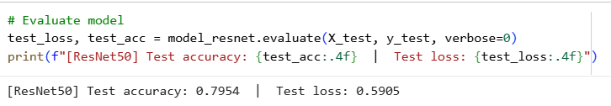
Model Evaluate (3/6)

Slide 16
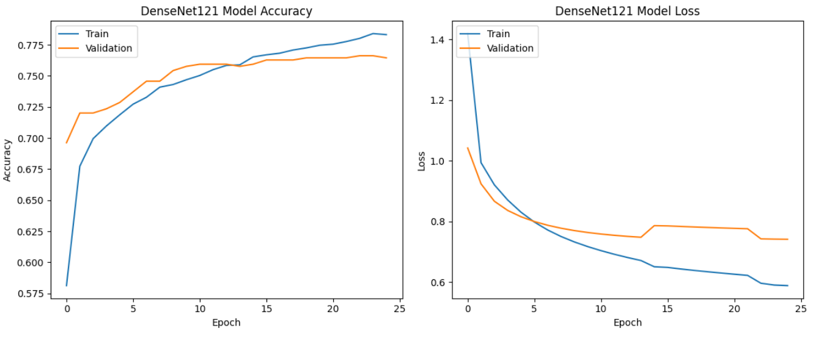
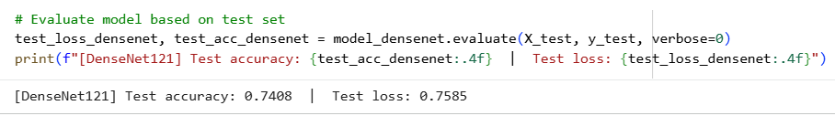
Model Evaluate (4/6)

Slide 17
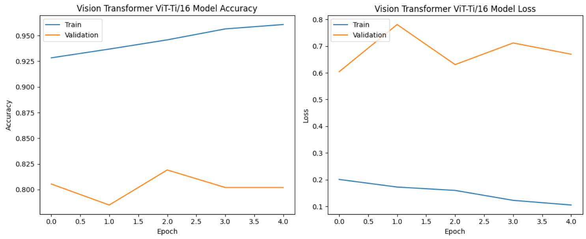
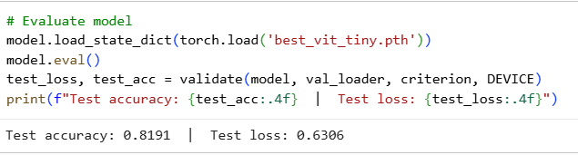
Model Evaluate (5/6)

Slide 18
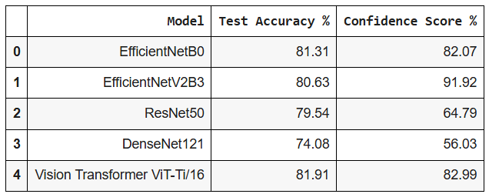
Model Evaluate (6/6)
EfficientNetB0 is chosen with the highest accuracy, 81.31% at the beginning, but Test Accuracy reduces to 78.04% after fine-tuning.
ResNet50 and DenseNet121 models misclassification. The image belongs to class 1 (Mild Diabetes), but models predict class 0 (No Diabetes).
Vision Transformer ViT-Ti/16 model is misclassification. The image belongs to class 1 (Mild Diabetes), but models predict class 2 (Moderate Diabetes).
EfficientNetV2B3 is the second choice for fine-tuning with a Test Accuracy of 80.63%.

Slide 19
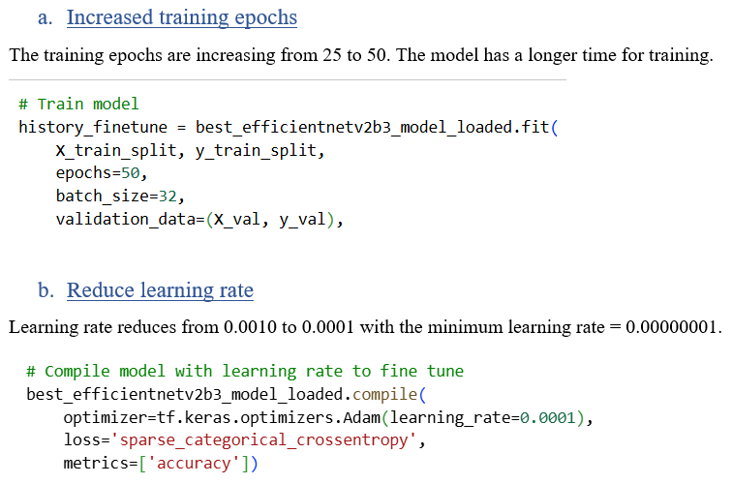
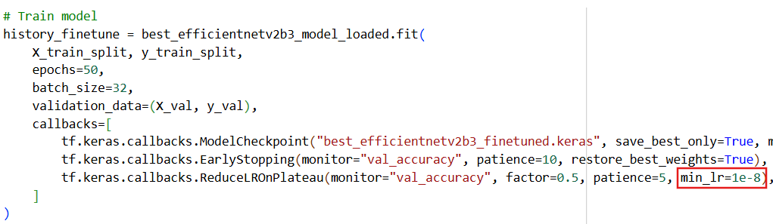
Enhancement

Slide 20
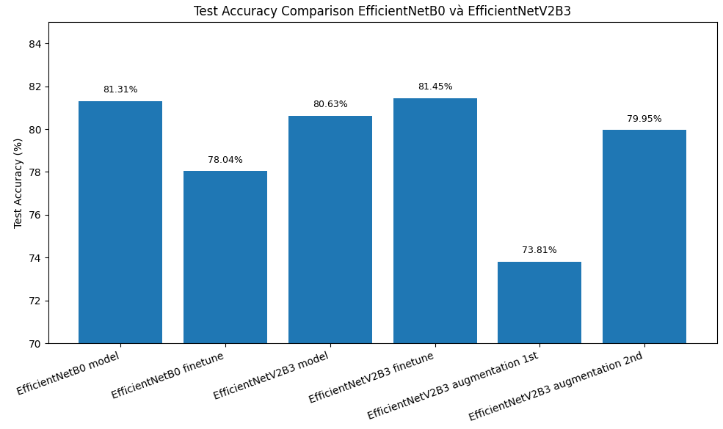
Overall Accuracy

Slide 21
Demo

Slide 22
Conclusion
This project aims to develop a deep learning model EfficientNetV2B3 using for Diabetic Retinopathy classification via retinal high-resolution images.
The steps, such as data preprocessing, model training, and evaluation, are implemented to create accurate and efficient classification.
The expected outcome is to reduce classification time, patients can have good treatment, and improve their life quality.

Slide 23
Scope of future works
Expand the Dataset for Greater Diversity
The current dataset, while effective for experimentation, could be expanded to include more images of other diseases, such as Cataract and Glaucoma.
Deploy the model on a website
Building an interactive interface (e.g., using Streamlit).
Increasing productivity in classifying disease and early treatment.
Integrate into the telemedicine system
In the countryside, the patient can take photographs of their retina at a facility near their home.
AI can help to classify it.

Slide 24
References (1/2)
Comparison between Normal Eye and Eye with Retinopathy. From Diabetic Retinopathy [Photograph], by Bobbi Nodell, 2020, (https://newsroom.uw.edu/news-releases/ai-technology-doesnt-reliably-detect-diabetic-eye-disease). 206.543.7129
The severity of Diabetic Retinopathy ranges from Normal to Proliferative. From Stages of DR [Photograph], by Prasanna Porwal, Samiksha Pachade, Ravi Kamble, Manesh Kokare, Girish Deshmukh, Vivek Sahasrabuddhe, Fabrice Meriaudeau, April 24, 2018, “Indian Diabetic Retinopathy Image Dataset (IDRiD)”, IEEE Dataport, https://dx.doi.org/10.21227/H25W98, (https://peerj.com/articles/cs-1947/). CC BY 4.0 DEED.

Slide 25
References (2/2)
Sovit Ranjan Rath. (2019). Diabetic Retinopathy 224x224 (2019 Data). Diabetic Retinopathy 224x224 (2019 Data)

Slide 26
Thank you

